Slide 1


Semantic Web in Health Care
KEERTHANA BA
MEGHANA S

Slide 2
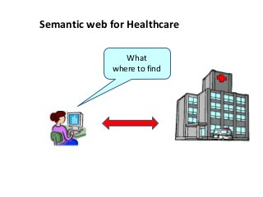
INTRODUCTION
Semantics Web technology provides tools that facilitate the handling and exchange of information between systemsVocabularies define the ideas and relationships.ontology-The formal description of knowledge as a collection of ideas and their interactions.

Slide 3

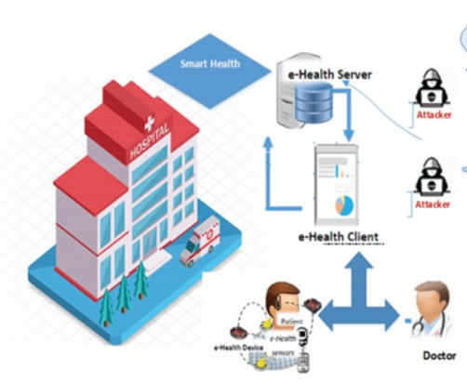
Healthcare information systems need to adapt to the challenges that lie in the process of health data management, such as scale, speed, and diversity, and use new methods and techniques to manage and process this data to obtain useful information and knowledge..

Slide 4

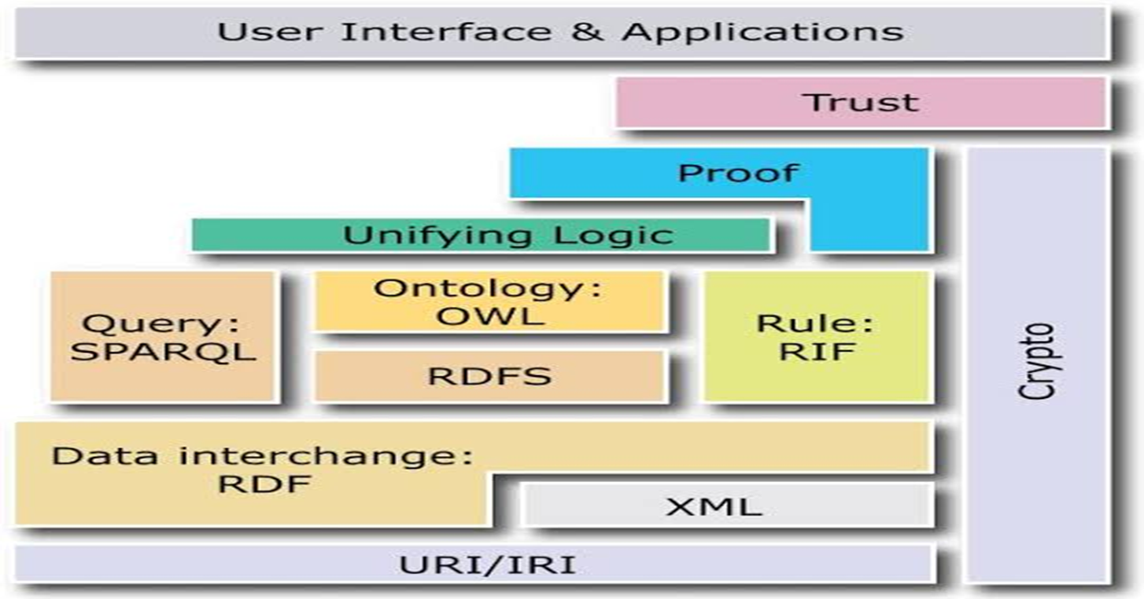
SEMANTIC WEB ARCHITECTURE

Slide 5

keywords
URI and Unicode layer: This layer provides a straightforward and protractile means for distinguishing resources
XML layer: This layer describes what is within the document, not what the documents sound like, whereas XML Schema provides grammars for legal XML documents.
Proof layer: This layer is employed for checking the validity of specific statements.
Trust layer: It is speculated to give a mechanism for trust and confidence between info sources and parities.
Program and Applications layer
Vertical layers
Digital signature

Slide 6

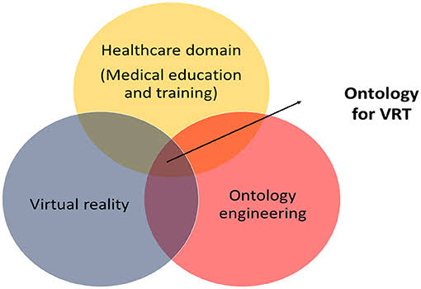
The ability to communicate amongst information systems is one of the most challenging tasks in healthcare. When paper-based medical records were preserved in folders, there existed a plethora of useful information that had no relation to one another. One of the most important characteristics of ontologies is that they enable automated data reasoning by including the crucial links between concepts

Slide 7
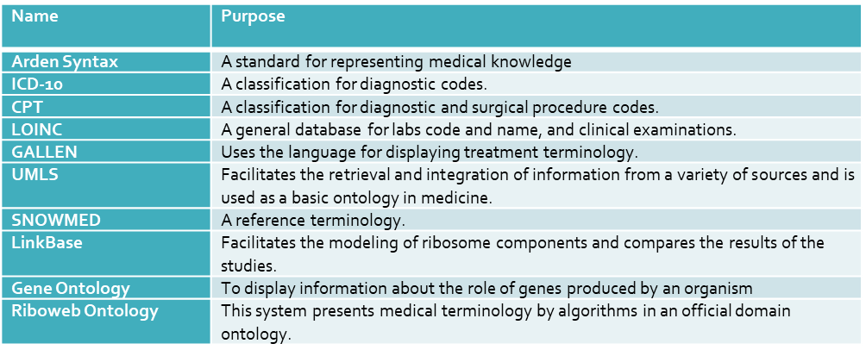
Few representative ontologies in the healthcare domain

Slide 8
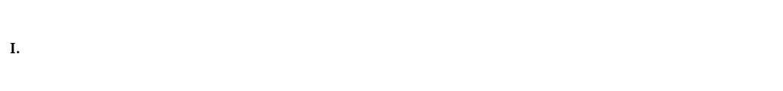
OWL2 has a rich collection of class constructions, it has a restricted collection of property capabilities.
The content's accessibility.
Another problem occurs from OWL's use of restrictions.
It will take a large amount of work to organise Semantic Web material, store it, and give the tools to discover it.

Slide 9
CONCLUSION
The Semantic web has gained popularity as a platform for information integration and analysis in the health domain.
In the medical science, information sharing is critical since most of the accessible medical data requires a way to be exchanged across several computer systems.
Ontology-based interoperation is meant for sharing knowledge and transferring information between individuals as well as between applications.

Slide 10
Thank you

